Slide 1
Lecture Slides
Advance Statistics

Slide 2
Correlation Analysis
Correlation Analysis is statistical method that is used to discover if there is a relationship between two variables/datasets.
Correlation Analysis can be done by using two methods.
(1) Scatter Diagram
(2) Karl Pearson’s/Product Moment Coefficient of Correlation

Slide 3
Scatter Diagram and Its Uses
Scatter diagram is the graphical representation of bivariate data.
Its main use is to observe and show the relationship, if any, between two quantitative variables.
Some examples of scatter diagram are given to estimate the values of coefficient of correlation in next slide.

Slide 4
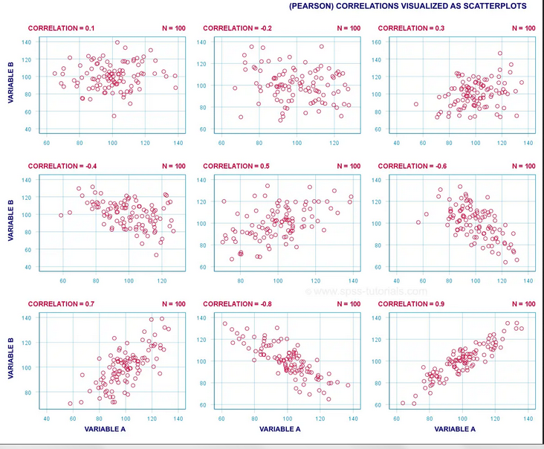

Slide 5
Difference between Covariance and Correlation
Covariance
Correlation
It measures the linear relationship between two quantitative variables.
It ranges from –∞ to + ∞.
It represents in square unit or product of two units.
It measures the linear relationship between two quantitative variables.
It ranges from -1 to +1.
It is unit less

Slide 6
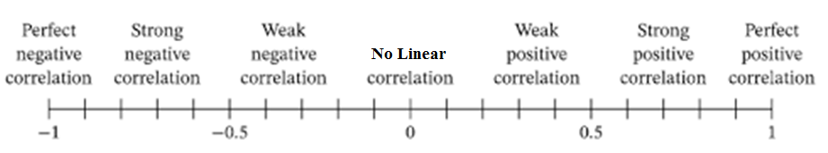
Coefficient of Correlation
Pearson's Product Moment Coefficient of Correlation (r).
It measures the strength of linear relationship between two variables or data sets.
Interpretations of Correlation coefficients

Slide 7
Assumptions of Coefficient of Correlation
Following are the assumptions of Correlation Coefficient
Two variables are recorded on Interval or ratio scale.
Two variables are linearly related.
Two variables follow normal distribution.
There is no bivariate outlier.
Note: If these assumptions are NOT fulfills, then we need to use Non-Parametric Measures for finding the correlation coefficient.

Slide 8
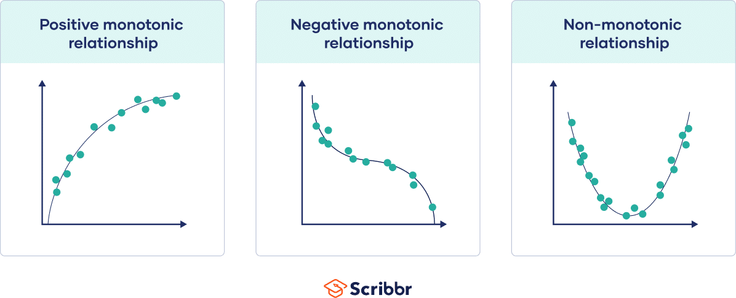
Non-Parametric Measures
Spearman’s Rank Correlation Coefficient
Kendall Tau Coefficient.
These measures also have 2 assumptions.
(1) Two variables are recorded on ordinal, interval or ratio scale.
(2) Two variables are monotonically related.

Slide 9
R-commands for Correlation
Consider we have two variables say, x and y.
Then to plot its scatter diagram by using R-command is plot(x,y)
For correlation
cor(x,y) # by default it will produce parsons correlation OR
cor(x,y,method="pearson") # for Pearson's correlation
cor(x,y,method="spearman") # for spearman correlation
cor(x,y,method="kendall") # for Kendall correlation

Slide 10

Testing of Correlation Coefficient
The Null hypothesis is
H₀: There is no correlation ( i.e. ρ=0)
H₁: There is correlation (i.e. ρ≠ 0)
Test Statistics:
Rejection rule is :
(i) By using Table Value: Reject H₀ if
(ii)By using P-Value:
Reject H₀ If p-value < specified level of significance

Slide 11
R-commands
To test the significance of correlation coefficient, we use following r-command for each method.
To test Pearson's coefficient of correlation
cor.test (x,y, method=“pearson”)
To test spearman coefficient of correlation
cor.test (x,y, method=“spearman”)
To test Kendall coefficient of correlation
cor.test (x,y, method=“kendall”)

Slide 12
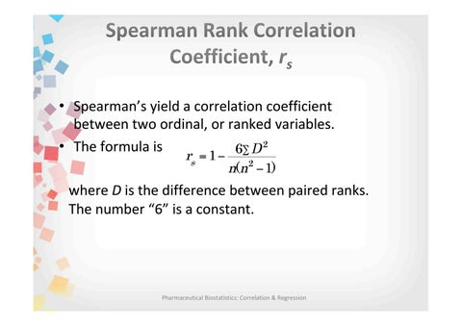

Slide 13
Example
Calculate rank correlation between sales and advertisement expenditure by using spearman’s Rank correlation method.
Put the sum of the squared ranks in the given formula you got the answer r_{s}= 0.9524.
This indicate high positive linear correlation between sales and advertisement cost.

Slide 14
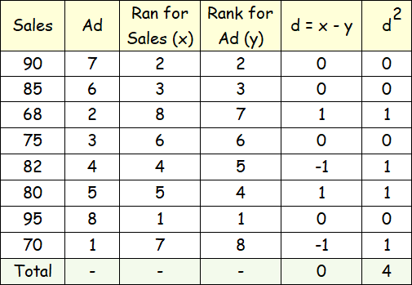

Slide 15
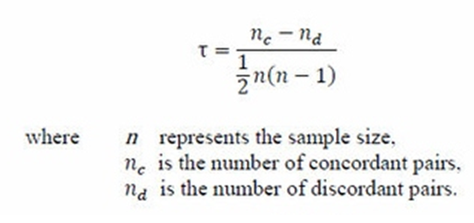
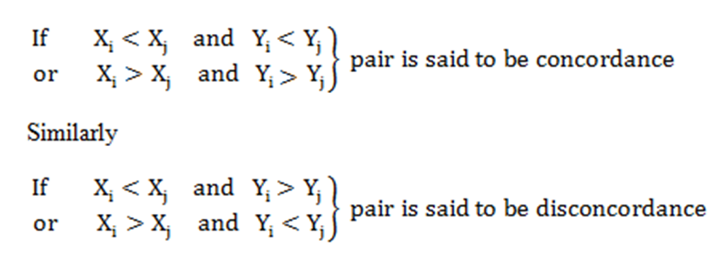
Kendall Correlation

Slide 16
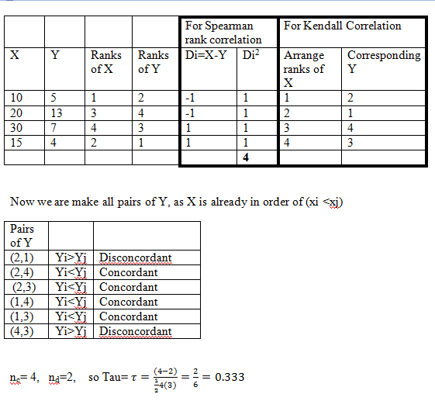

Slide 17
Regression Analysis
The dependence of one variable on one or more other variables (independent variables) is called regression Analysis.
If we have one dependent variable and one independent variable then regression is called Simple regression. i.e.
If we have one dependent variable and two or more independent variable then regression is called multiple regression. i.e.

Slide 18
Linear Regression Model
When regression line is in the form of straight line then it is called linear regression line.
When we are asking about linearity this means linear in parameters.

Slide 19
Parameter Estimation Of Simple Linear Regression Model (SLR)
Estimated simple Linear Regression Model is
Estimate parameters by using calculator or using R-command).
Estimated Multiple Linear Regression model is
a=y-intercept. (It is the value of y when x=0)
b=Slope or regression coefficient.
(It indicate the average amount of change in y due to the unit change in x)

Slide 20
Residuals in Simple Regression Analysis
The difference between actual value of dependent variable and predicted value.

Slide 21
Assumption of Linear Regression Model
The regression model is linear
All the explanatory (independent) variables are fixed and independent.
For the given values of explanatory variable, mean of error terms is zero.
For the given values of explanatory variable, variance of error terms is constant (Assumption of homosecdasticity).
For the given values of explanatory variable, there is no auto-correlation between the error terms.
There is no exact linear relationship between explanatory variables (Assumption of No multicollinearity).
Note: Assumption # 6 apply only in case of multiple regression. Remaining assumptions are for both simple and multiple regression.

Slide 22
Standard Error of Estimates
A measure of the average deviation of the errors (the difference between the ^y -values predicted by the regression model and the y –values) in the sample. The standard error of the estimate for the regression model is the standard deviation of the errors/residuals.
The degree of scatterness (or dispersion) of the observed values about the regression line is measured by what is called SE of estimate/ SD of regression.

Slide 23
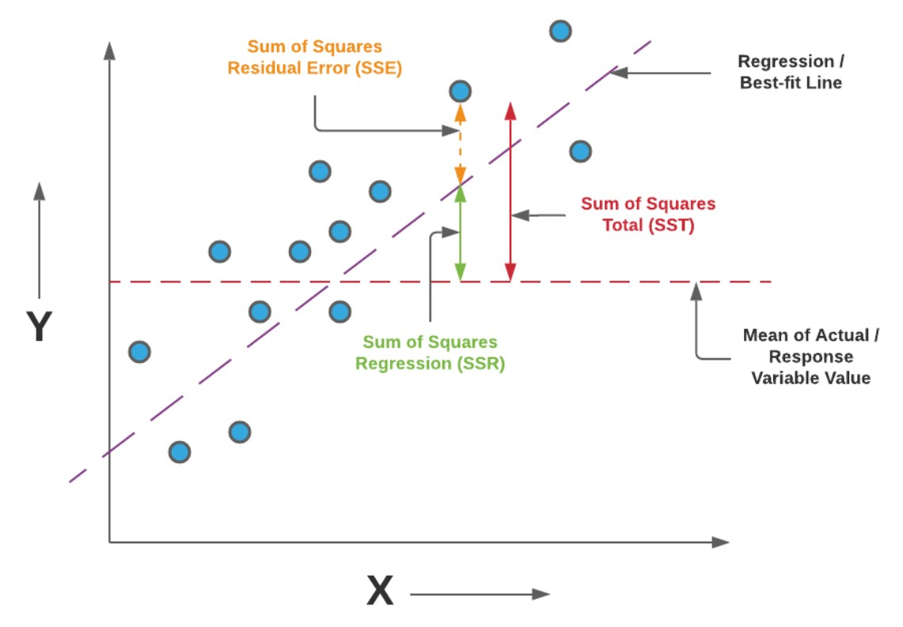

Slide 24
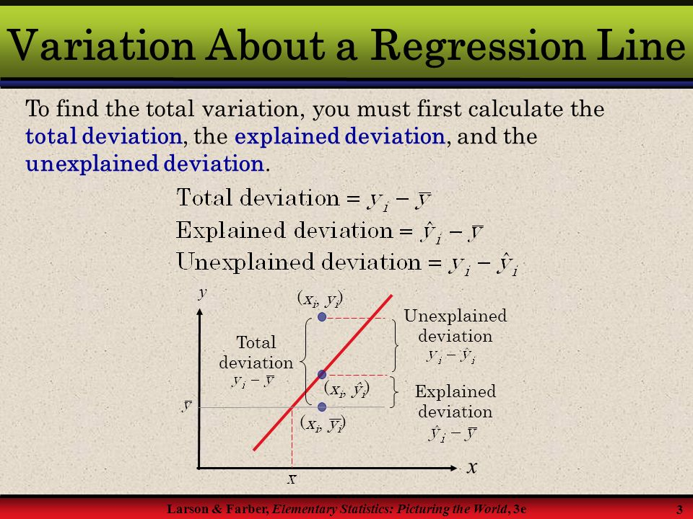

Slide 25

Calculating Standard Error of Estimate
The smaller the value of a standard error of estimate the closer are the dots to the regression line and better is the estimate based on the equation of the line.
If the standard error is zero, then there is no variation corresponding to the computed line and the correlation will be perfect.
E.g. if s_{yx}= 2.5, it indicates that for a specific independent variable, on average actual dependent variable may different from predicted variable by the amount 2.5 units.

Slide 26


Coefficient of Determination
Or simply square the value of correlation coefficient (i.e. square of r)

Slide 27
Interpretation of R²
It ranges between 0 and 1.
If r²=1, signifies that 100% of the variability in the dependent variable is associated with the regression equation.
If r²=0, it means that none of the variability in the dependent variable is explained by independent variable.
If r²=0.83 (say), it indicates that 83% of the variability in dependent variable is explained by independent variable and 17% of the variation is due to the chance or other factors.

Slide 28
Example simple Linear Regression
A survey of pocket money received by children in a primary school was made by choosing at random four children of each of the ages 5, 7, 9 and 11 years. The amounts of pocket money received are given below
Age (years) | Pocket Money (Rs.)
5 | 2, 8, 10, 12
7 | 9, 13, 14, 16
9 | 9, 14, 16, 21
11 | 18, 19, 23, 36

Slide 29
R-code to fit Linear Regression
rm(list=ls())
library(lmtest)
PM=c(2,8,10,12,9,13,14,16,9,14,16,21,18,19,23,36) #Pocket Money in Rs.
Age=c(5,5,5,5,7,7,7,7,9,9,9,9,11,11,11,11) # Ages in Years
plot(Age,PM)
reg=lm(PM~Age)
reg
summary(reg)
abline(lm(PM~Age))
res=residuals(reg)
plot(res)
# To learn the concept of TSS, RSS and ESS
ybar=mean(PM)
lines(1:16,rep(ybar,16))
dwtest(reg)

Slide 30
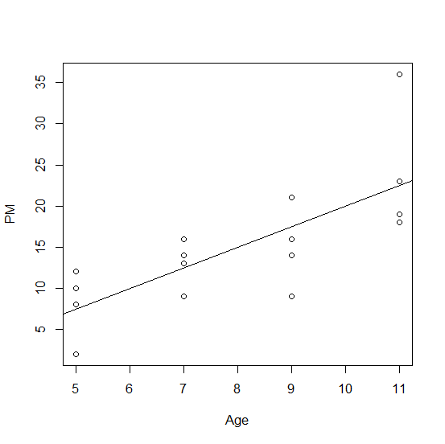
Scatter Plot and Fitted Line

Slide 31
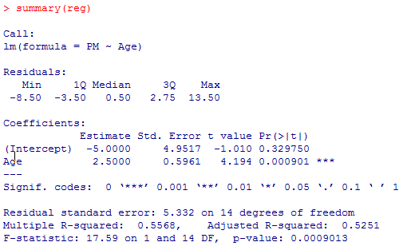
Out-put of R-code

Slide 32
We are to test the overall significant of fitted model
(i.e. H_{o}: Fitted model is good, H₁: Fitted model is not good)
Since p-value of F-statistics is less than 0.05, we can say that overall model is good fitted.
Individual significance of intercept )
i.e. (Ho: α=0 , H₁: α≠0
Since p-value of constant is greater than 0.05 so intercept is insignificant.
Individual significance of regression coefficient )
i.e. (Ho: β=0 , H₁: β≠0
Since p-value of regression slop is less than 0.05 so regression coefficient is significant. i.e. Age has significant effect on Pocket Money

Slide 33
Durbin Watson Test (Failour of Assumption 5)
To test the OLS assumption that, “there is no auto-correlation between the error terms”, one can use theoretical test known as Durbin Watson Test.
Hypothesis are given as
H_{o}: There is no auto-correlation between the error terms.
H₁: There is auto-correlation between the error terms.

Slide 34
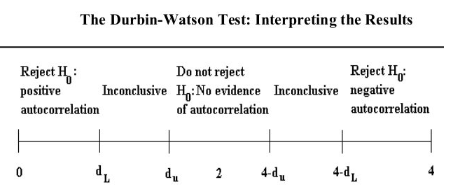

Slide 35
Application of DW-Test on previous data
Durbin-Watson test
data: reg
DW = 1.4497, p-value = 0.07297
alternative hypothesis: true autocorrelation is greater than 0.
Conclusion: Since P-value is greater than specified level (5%) so we do not reject Ho. This shows that there is no auto-correlation in the data.

Slide 36
Example 2: Auto-correlation (Assumption 5 fails to fullfil)
In an experiment to measure the stiffness of a spring, the length of spring under different loads was measured. The regression equation appropriate for predicting the length on the basis of weight as
Where y is the length and x is the weight.
The residuals and observed data are as follows:

Slide 37
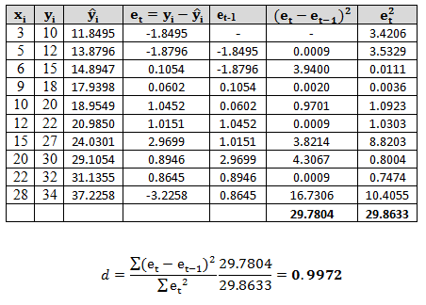
Testing of DW Test Manually

Slide 38

From the DW table with k=1 the critical value dL=0.879, dU=1.32
Since DW calculated value falls between the dL and dU. So No conclusion can be drawn about auto-correlation.
It is batter to calculate p-value of DW test for the conclusion.
Now , by applying r-code
Since P-value is less than 0.05, so we reject Ho. Concluding that there is Auto-correlation.

Slide 39
Hetroskedasticity (Failour of assumption 4)
When the OLS assumption “variance of error terms is constant” fails to fullfil. Then we say that there is hetroskedasticity. To test this assumption we have two methods.
Graphical Methods
Rank Correlation between estimated Y ( )and absolute residuals (|ε|)of model.

Slide 40
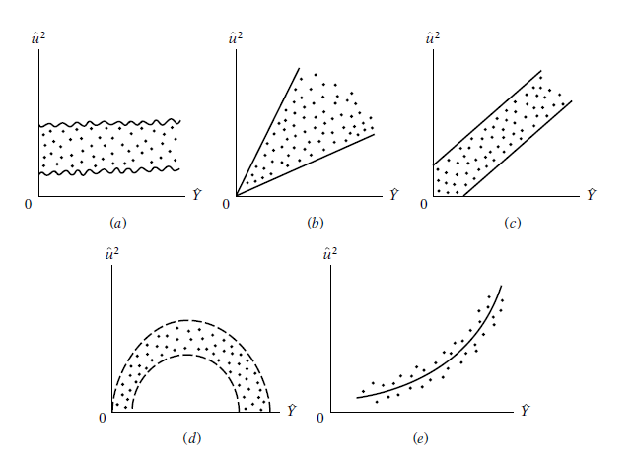
Graphical Methods to detect Heteroscedasticity

Slide 41
Interpretation of Graphical Method
In above figures are plotted against . , the idea being to find out whether the estimated mean value of Y ( ) is systematically related to the squared residual ( ). In Figure a we see that there is no systematic pattern between the two variables, suggesting that perhaps no heteroscedasticity is present in the data. Figure b to e, however, exhibits definite patterns. For instance, Figure c suggests a linear relationship, whereas Figure d and e indicates a quadratic relationship between and .

Slide 42

Test of Rank Correlation for Heteroscedasticity
Consider the following data for the illustration of of the detectionof heteroscedasticity using the Spearman Rank correlation test.
Y | X2 | X3
11 | 20 | 8.1
16 | 18 | 8.4
11 | 22 | 8.5
14 | 21 | 8.5
13 | 27 | 8.8
17 | 26 | 9
14 | 25 | 8.9
15 | 27 | 9.4
12 | 30 | 9.5
18 | 28 | 9.5

Slide 43
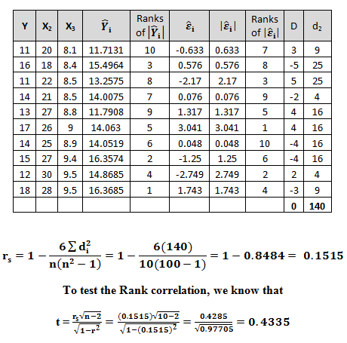

Slide 44
Testing Procedure for Heteroscedasticity
H_{o}: There is no evidence of the systematic relationship between the explanatory variables, and the absolute value of the residuals (There is no evidence of heteroscedasticity) .
The value of t from the table at 5% level of significance at 8 degrees of freedom is 2.306.
Since so, there is no evidence of the systematic relationship between the explanatory variables and the absolute value of the residuals (i.e. There is no evidence of heteroscedasticity in the data)

Slide 45
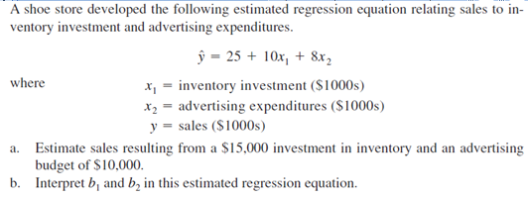
Example of Multiple Regression

Slide 47
Practice Question
In an experiment to measure the stiffness of a spring the length of the spring under different loads was measured as
Length (y) : 10 12 15 18 20 22 27 30 32 34
Weight(x): 3 5 6 9 10 12 15 20 22 28
Fit the simple linear regression model and compute the residuals
Test the heteroscedasticity at 5 % level of significance using Spearman rank correlation Test.

Slide 48
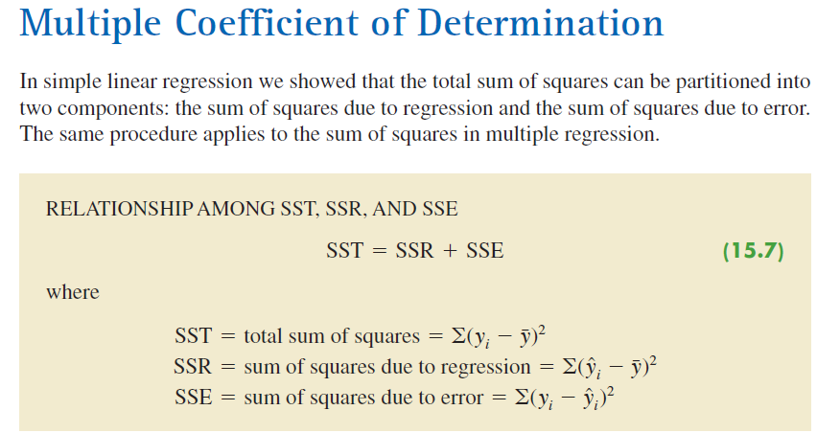
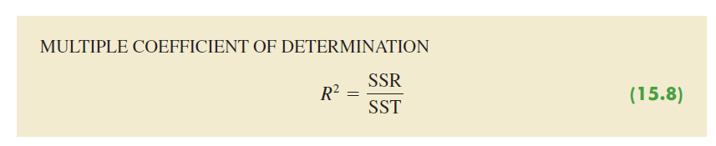

Slide 49
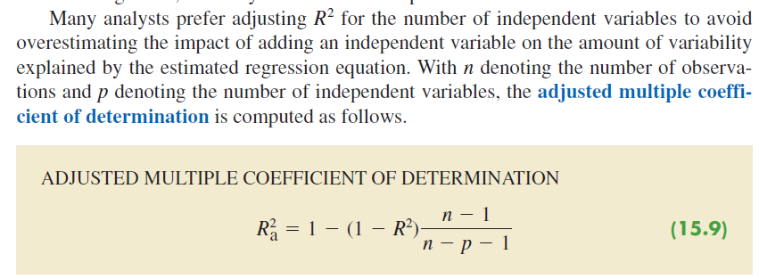
Adjusted Multiple coefficient of Determination

Slide 50
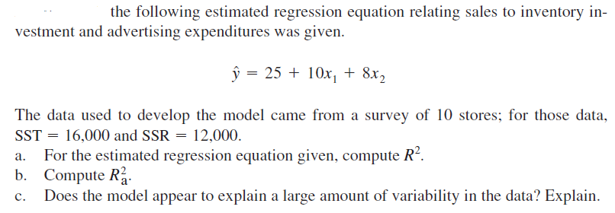
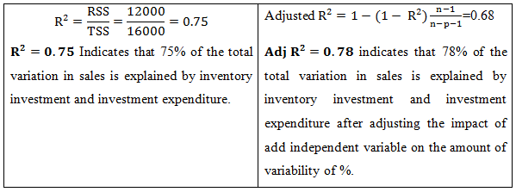

Slide 51
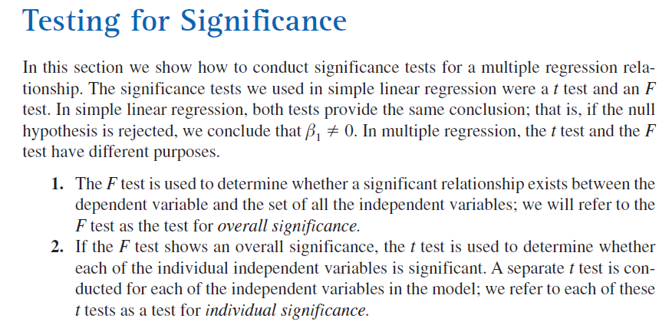
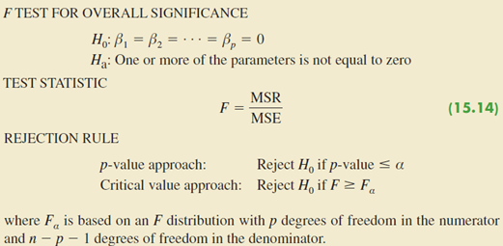
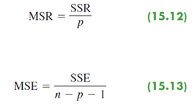

Slide 52
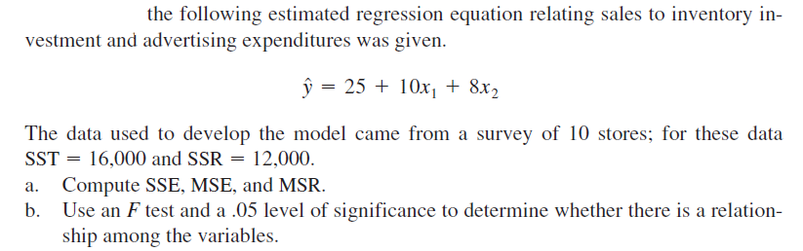
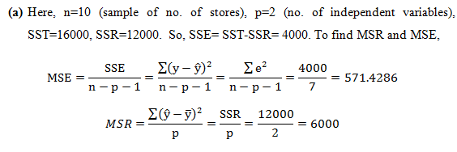
Example

Slide 53
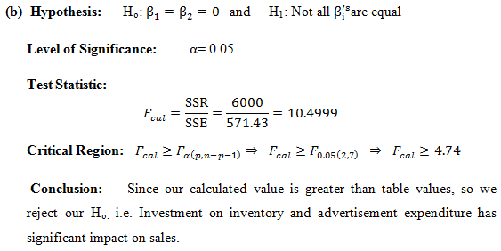

Slide 54
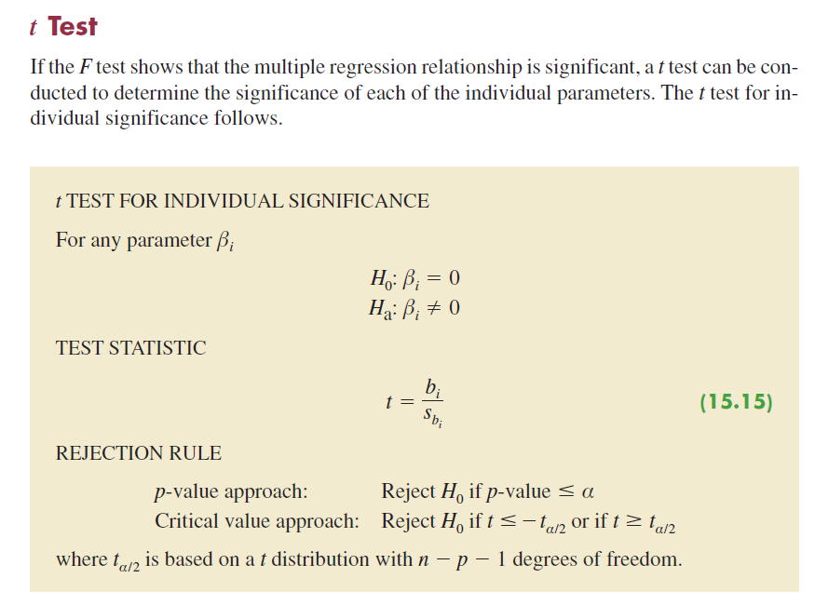

Slide 55
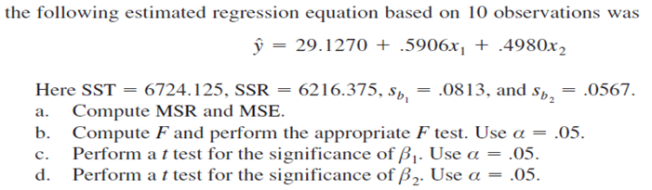
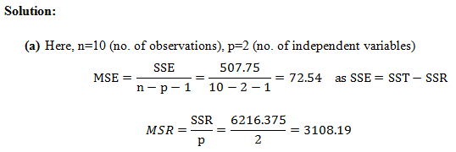

Slide 56
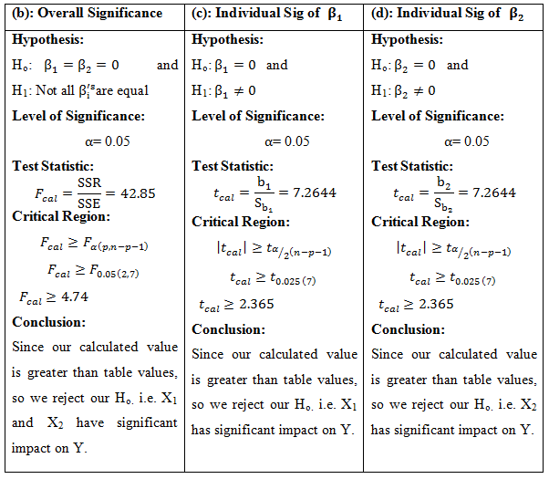

Slide 57
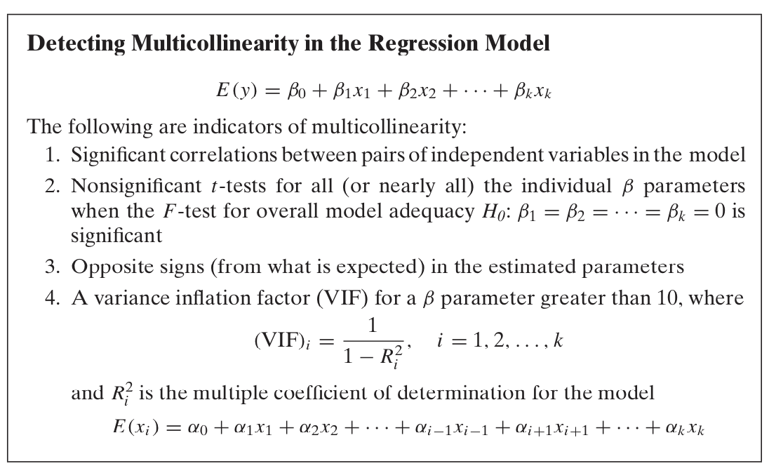

Slide 58
Question (Multicollinearity)
A data analyst is want to predict the price of games app. The price of the games varies with respect to the rating of apps and number of downloading of the apps. Therefore, Data analyst consider the two independent variables; ratings of apps, number of downloading of the apps, for predicting the price of apps. He collects the data for 10 games apps. The multiple linear regression model is used and the estimated regression model is given as
The correlation matrix between independent variables is given as
x₁ x₂
x₁ 1 0.95
x₂ 0.95 1
Compute the variance inflation factor (VIF) and comment on the multicollinearity.

Slide 59
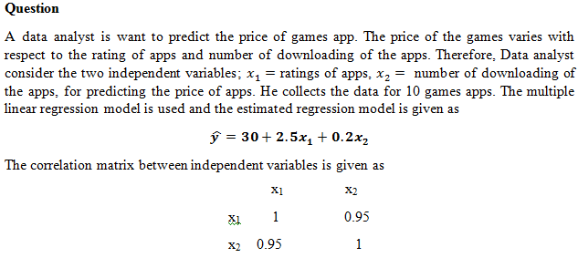
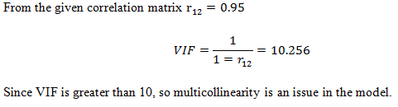

Slide 60
Shapiro-Wilk test for Normality
Normality means that a particular sample has been generated from a Normal/Gaussian distribution. It doesn’t necessarily have to be a standardized normal distribution (with 0 mean and variance equal to 1). There are several situations in which data scientists may need normally distributed data:
To compare the residuals of linear regression in the training test with the residuals in the test set using an F-test
To compare the mean value of a variable across different groups using a One-Way ANOVA test or a Student’s test
To assess the linear correlation between two variables using a proper test on their Pearson’s correlation coefficient

Slide 61
Unfortunately, data is not always normally distributed, although we can apply some particular transformation to make a distribution more symmetrical (for example, a power transformation).
A good way to assess the normality of a dataset would be to use a Q-Q Plot, which gives us a graphical visualization of normality. But we often need a quantitative result to check and a chart couldn’t be enough.
That’s why we can use a hypothesis test to assess the normality of a sample.

Slide 62
Shapiro-Wilk test in R
The Shapiro-Wilk test is a hypothesis test that is applied to a sample and whose hypothesis is as under
H_{o}: The sample has been generated from a normal distribution.
If the p-value is low, we can reject such a null hypothesis and say that the sample has not been generated from a normal distribution.
In R following is the syntax for Shapiro-Wilk Test. Consider we are interested to test normality of a variable (say x), so it
Syntax is shapiro.test(x)
# ShapiroResult (statistic=0.0000, pvalue=0.0000)

Slide 63
Logistic Regression
In many regression applications the dependent variable may only assume two discrete values.
For instance, a bank might like to develop an estimated regression equation for predicting whether a person will be approved for a credit card. The dependent variable can be coded as y 1 if the bank approves the request for a credit card and y 0 if the bank rejects the request for a credit card.
Using logistic regression we can estimate the probability that the bank will approve the request for a credit card given a particular set of values for the chosen independent variables.

Slide 64
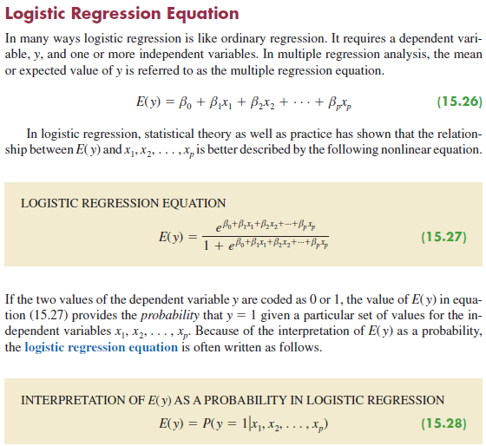

Slide 65
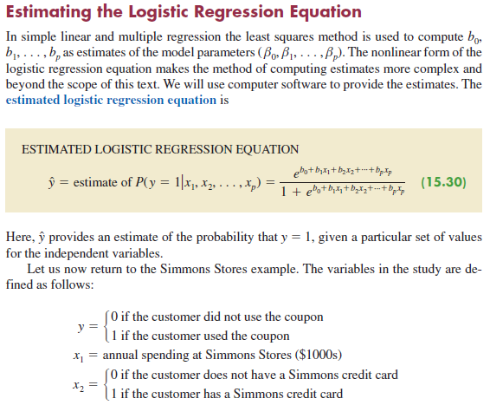

Slide 66
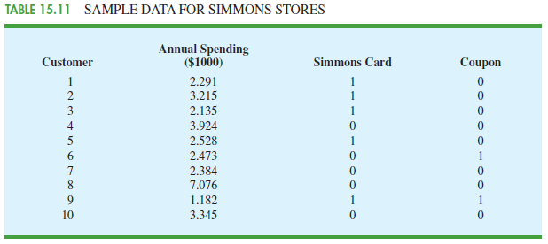
Example of Logistic Regression

Slide 67
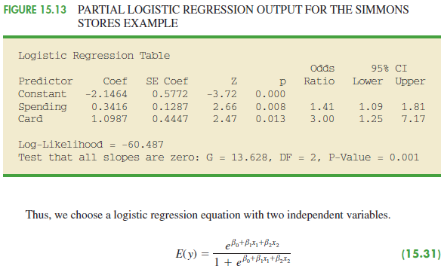

Slide 68
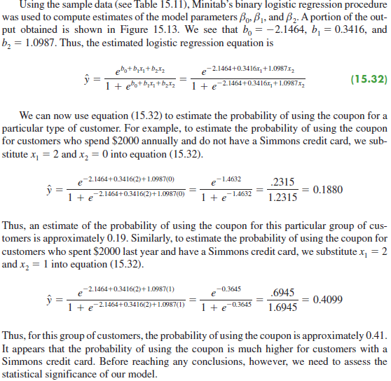

Slide 69
Reference Logistic Regression
STATISTICS FOR BUSINESS ANDECONOMICS 10TH Edition
By
David R. Anderson, University of Cincinnati
Dennis J. Sweeney, University of Cincinnati
Thomas A. Williams, Rochester Institute of Technology
Chapter 15, topic 15.9

